Slide 1
DermAI
Skin disease detection
Team Thunder Buddies Sprint 2

Slide 2
Agenda
Team Members
Improvement
Project Description
Teamwork agreement
Personas
MVP
Languages and tools
Algorithms
Diagrams
Sprint 2 tasks and stories
User Stories and acceptance criteria
Project Schedule
Burndown chart
Project Backlogs
Retrospective
Sprint 3 updates
Application Screenshots
Test Cases
Demo Video of application

Slide 3
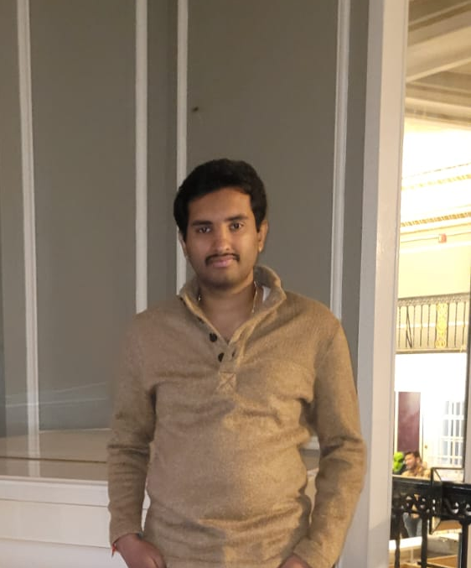
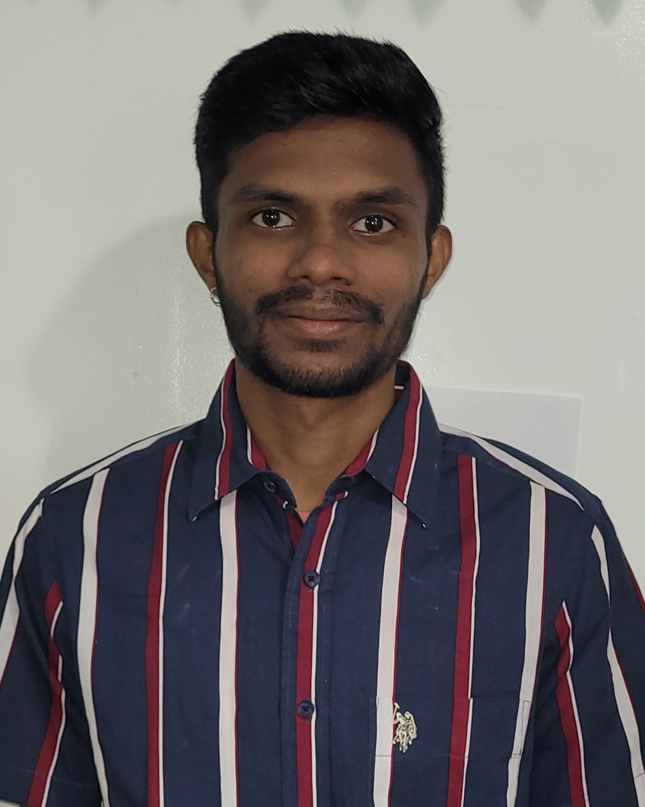
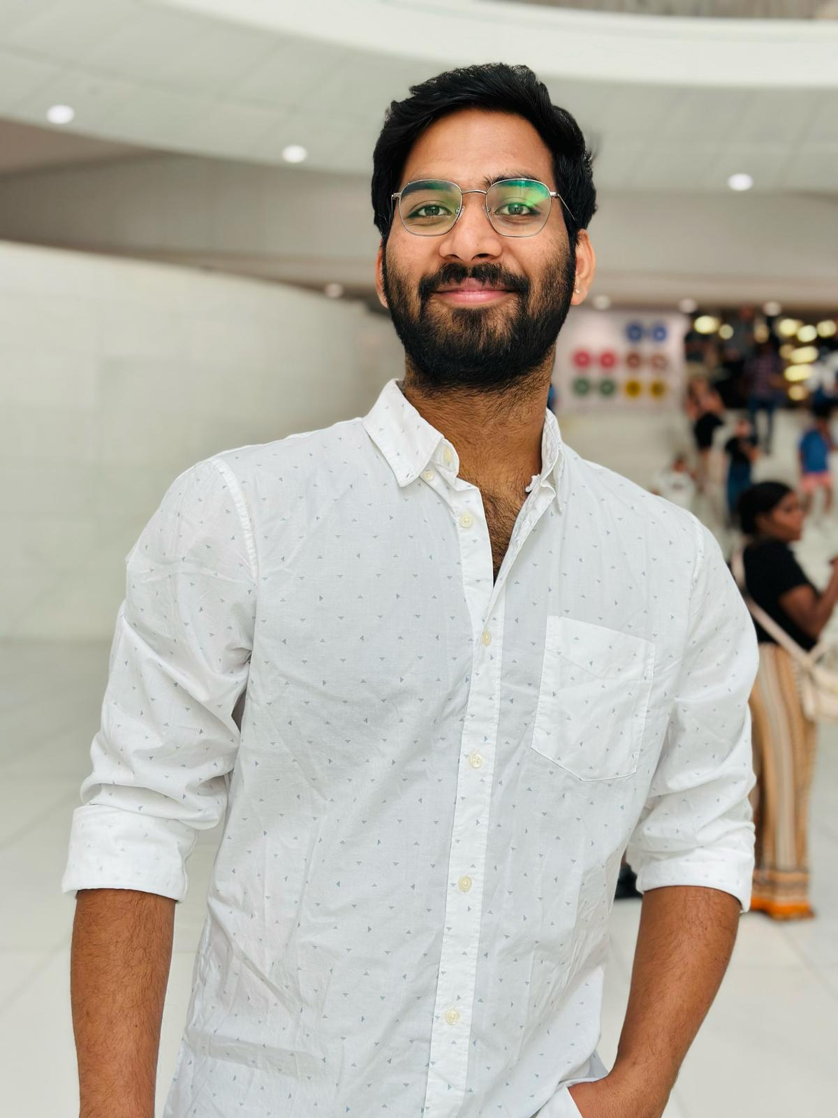
Team Members
Bhargava Chilukuri
Front end developer
Kushal arya neela
Front end developer
Manideep Kumar Reddy Kotha
Backend developer

Slide 4
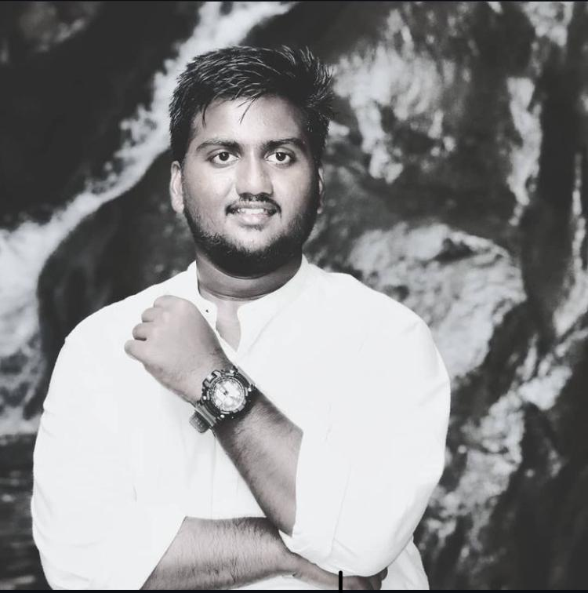
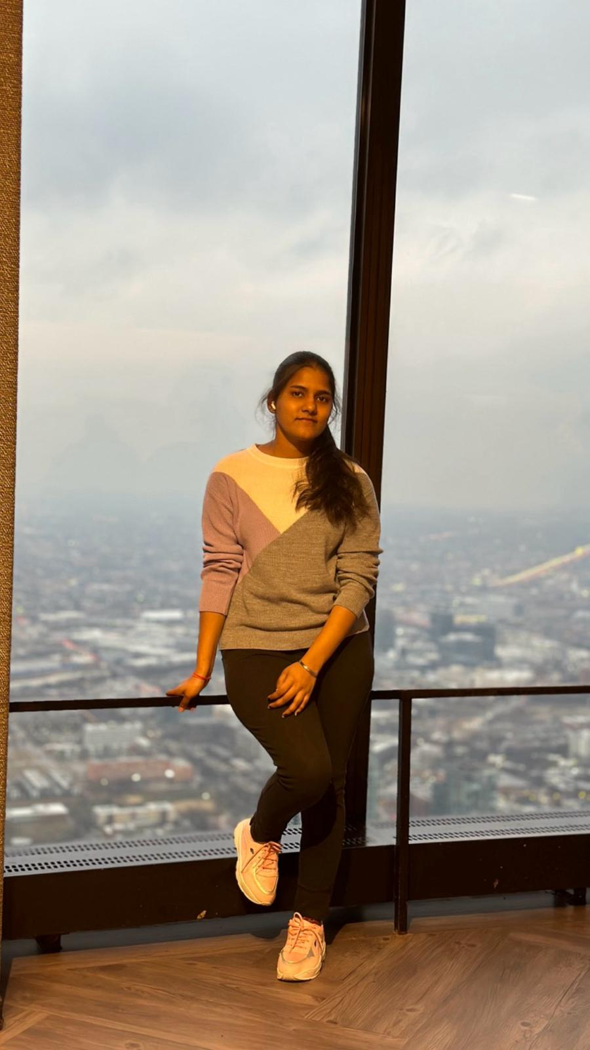
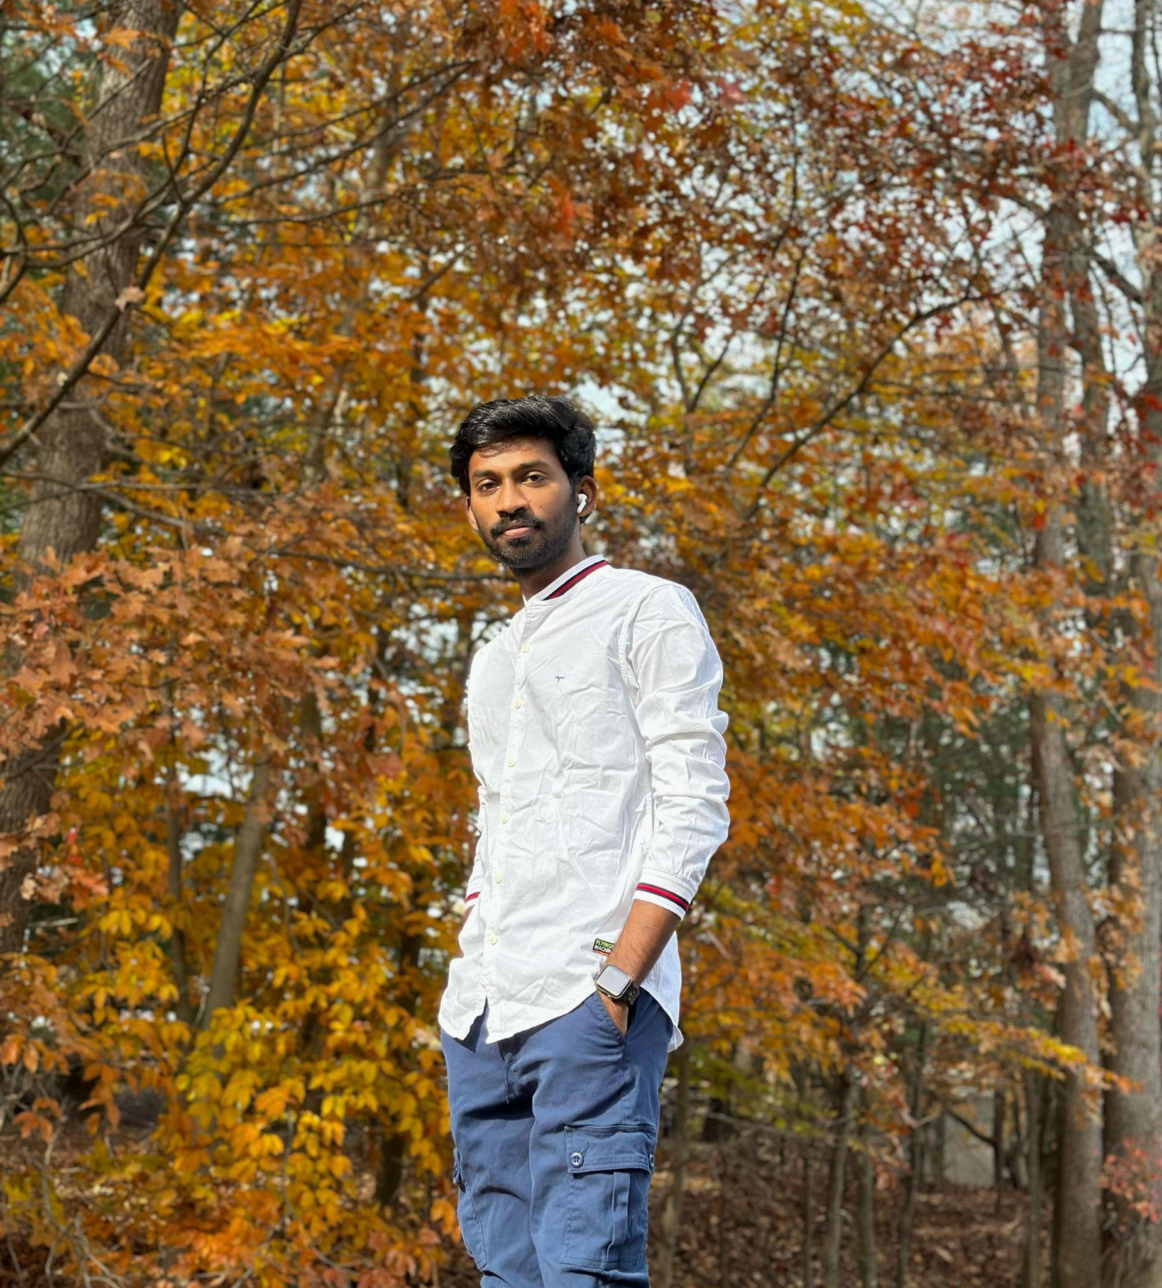
Jagadeesh Mekhapotula
Backend Developer and Tester
Akshara Uppu
Backend Developer
Sai Praneeth Chagiri
Front-end Developer

Slide 5
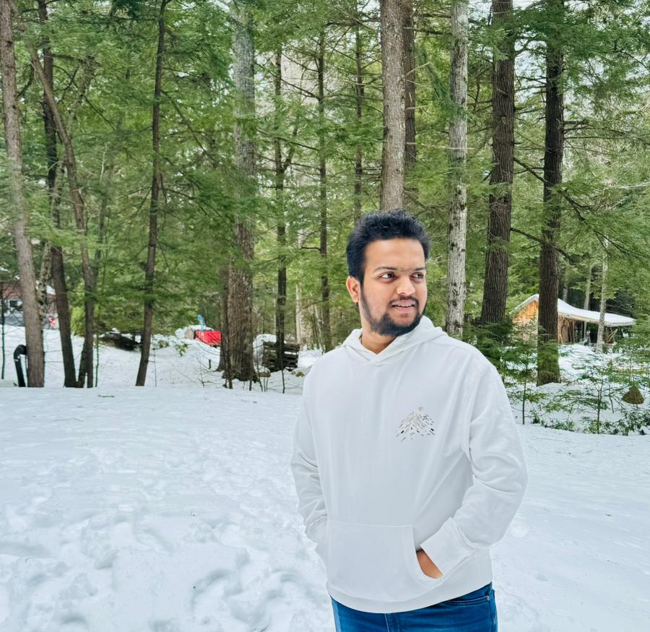
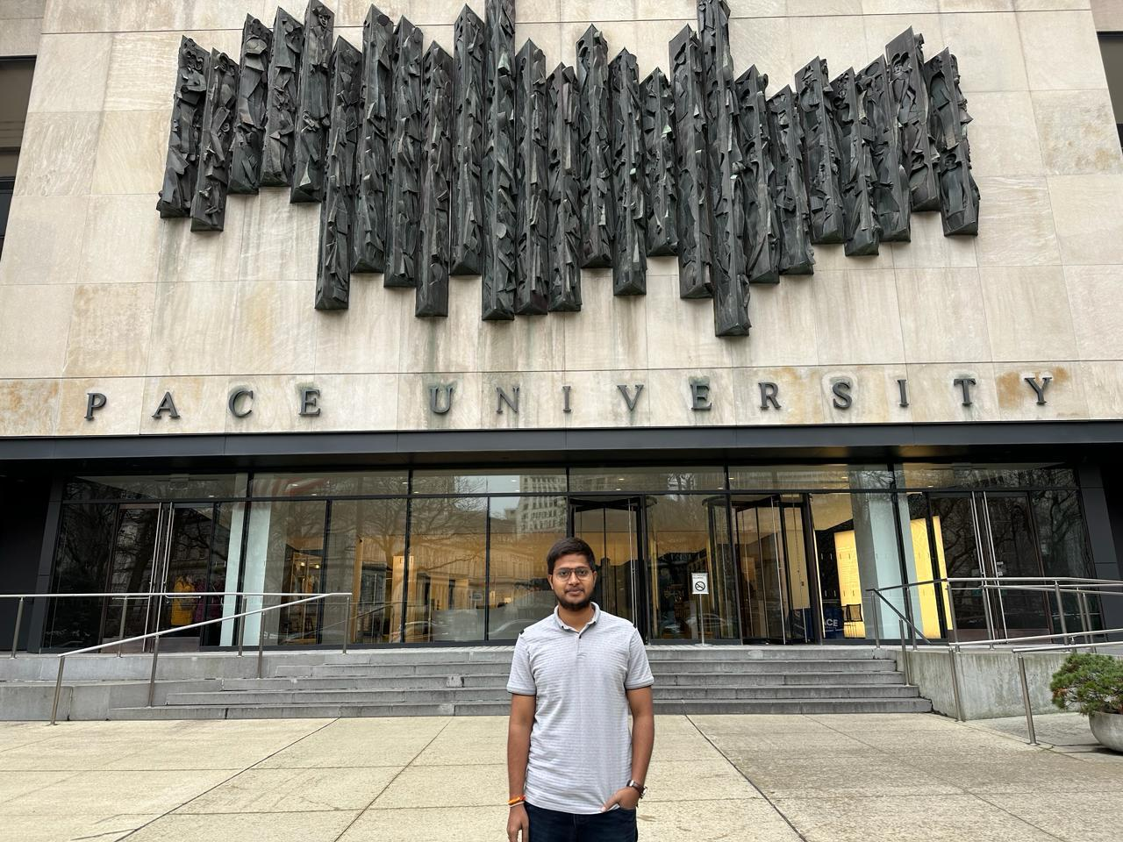
Srinath Madagoni
Machine learning engineer
Manoj Kumar Madhavarapu
Machine learning engineer

Slide 6
Improvements after Professor’s Feedback
Updated the sprint and design
Team roles updated
Added more details in personas
Removal of market analysis
Detail description on Technologies
More detailed retrospective
Addition of link to Wiki Page
Updated team agreement

Slide 7
Problem Statement
The diagnosis of the dermatological problem is quite complex and requires expert knowledge and accurate results. At present digital solutions lack accuracy and simplicity usage of the application. Thus ,it creates a gap between the human solution and the digital solution. So DermAI comes in place which has a user-friendly interface and employs deep learning to diagnose skin conditions and give precision results. Which empowers everyone from general public to have expert dermatologists in their hands.

Slide 8
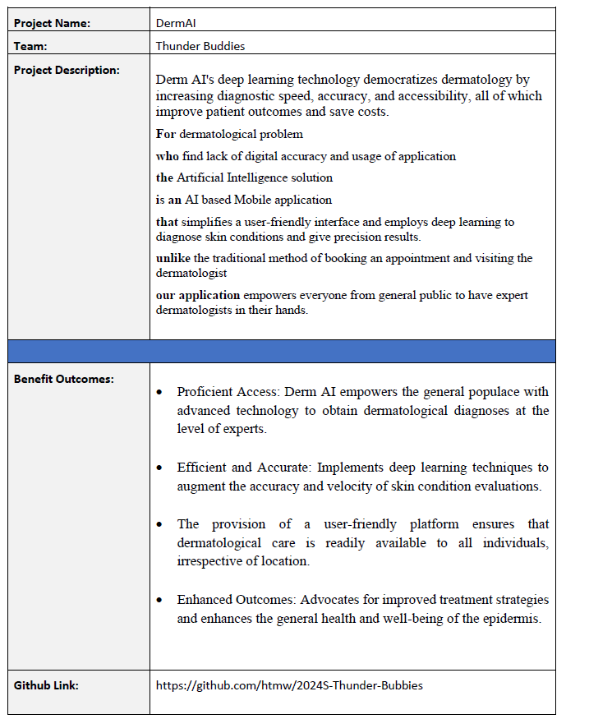
Project Description

Slide 9
Teamwork Agreement
Team Name: Thunder Buddies
Our goal is to bring collaborative knowledge and skills together for the completion of the Computer Science Capstone Project. Our project might have challenges to tackle and we would overcome challenges and deliver the project on time.
Team Agreement
1.All teammates should share their opinions and even respect each other's opinions. The sharing of information should be transparent, if any of the team members is having any issue, they can react to other team members and try to solve the issue. If any teammates have new ideas and thoughts, they can share in our sprint meetings.
2.Team Members should be responsible for their respective tasks and deliver the required project deliverables before the due date and if they are unable to finish it before the due date, they can reach out to other members.
3.All the roles are given based on your strengths , ideas and commitment and there shouldn't be any conflict between team members regarding roles.
4.Communication between front end, backend and machine learning team should be interactive and weekly 2 meetings will be held one on Wednesday and the other on Saturday and all team members are requested to take part in the team meetings and all communications are done via Slack.
5.If any team member is unable to attend the meeting, then they have to prior inform the scrum master about it, and missing any team meeting is not advisable.
6.All members should equally take part and give their best effort.

Slide 10
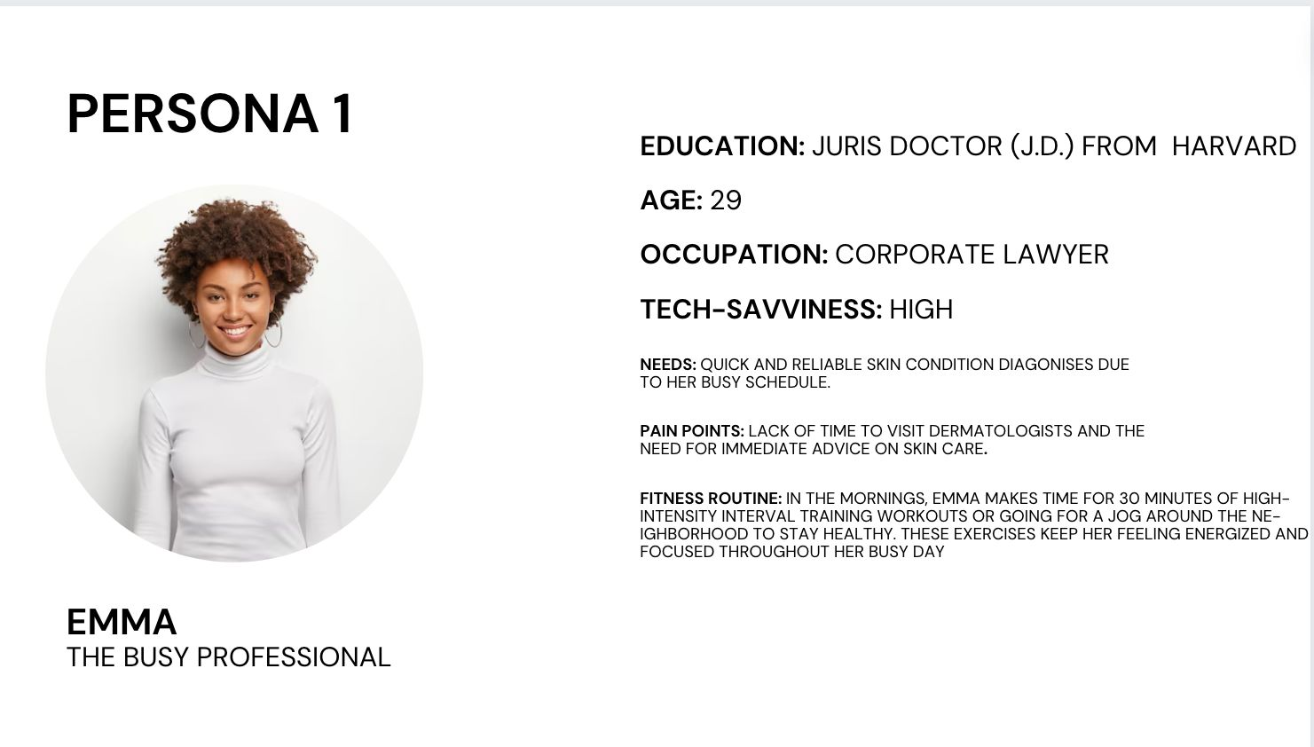

Slide 11
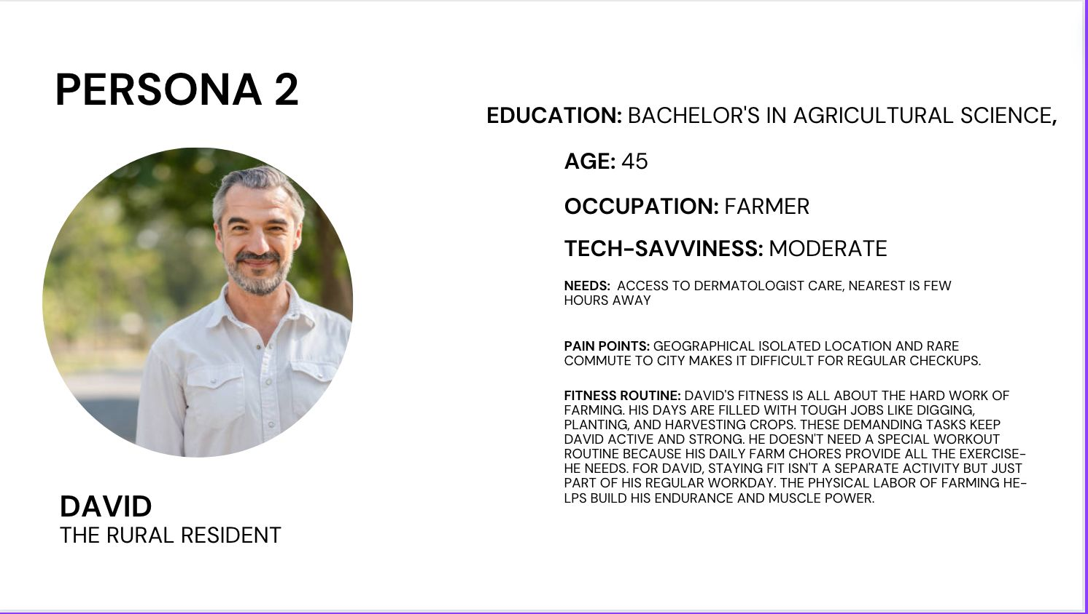

Slide 12
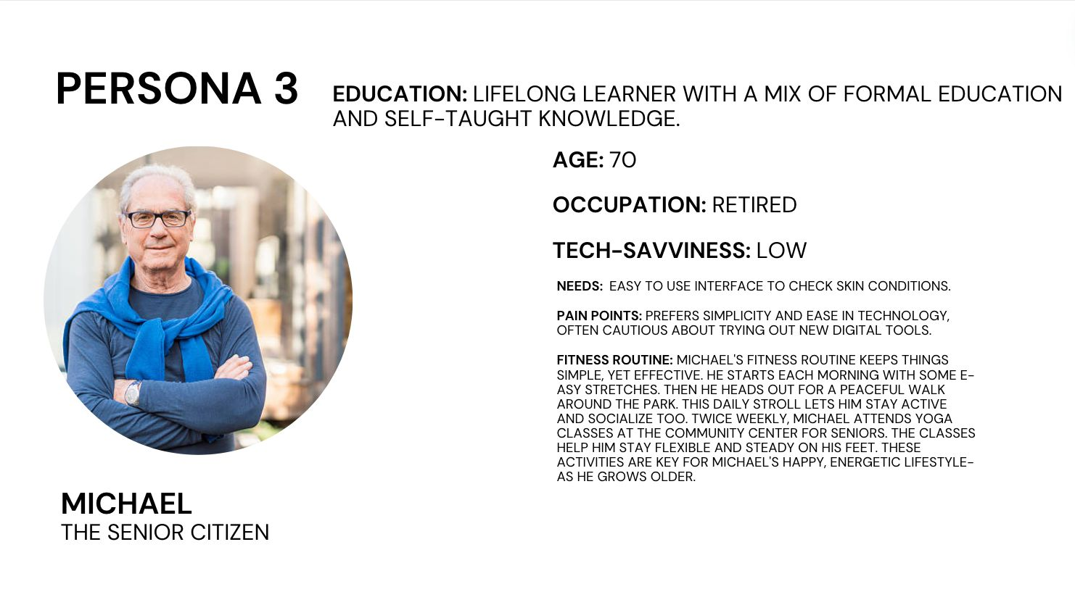

Slide 13
MVP (Minimum Viable Product)
Home Screen: Simple UI
Photo Screen: Upload/Capture
Analysis Screen: Results
Profile Screen: User Info
Login Screen: Authentication

Slide 14

Language and Tools - Frontend
Expo is react native wrapper which makes developing an mobile application faster and it does most of complex just by npx create-expo-app my-app.

Slide 15


Language and Tools - Backend
For backend both flask and node js has been used. Flask is mainly to create a machine learning model api which is going to be connected via node js. Node js is mainly used to do basic CRUD operations.

Slide 16

Language and Tools - Backend
Tensorflow is a machine learning framework and it is used to build Image classification model. For this project, tensorflow is used to build skin disease classification model.

Slide 17



Language and Tools - Other technologies
Docker is used for containerizing dependencies which ensures portability, consistency and scalability. Firebase is used for authentication and database where as digital ocean is used of running the backend code and run those apis on cloud then in local machine.

Slide 18
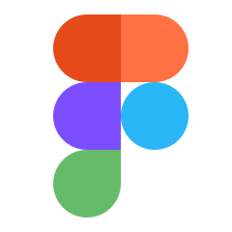

Language and Tools - Design Tools
Those 2 are the design tools and these are mainly used for design UI and for flowcharts.
Figma is used for UI design whereas Miro is used for designing charts.

Slide 19
Algorithms
CNN Algorithms:
CNNs uses layered architecture to process visual data, extracting features through filters for image recognition tasks.
EfficientNet:
EfficientNet scales CNNs uniformly across width, depth, and resolution, enhancing efficiency and accuracy.

Slide 20
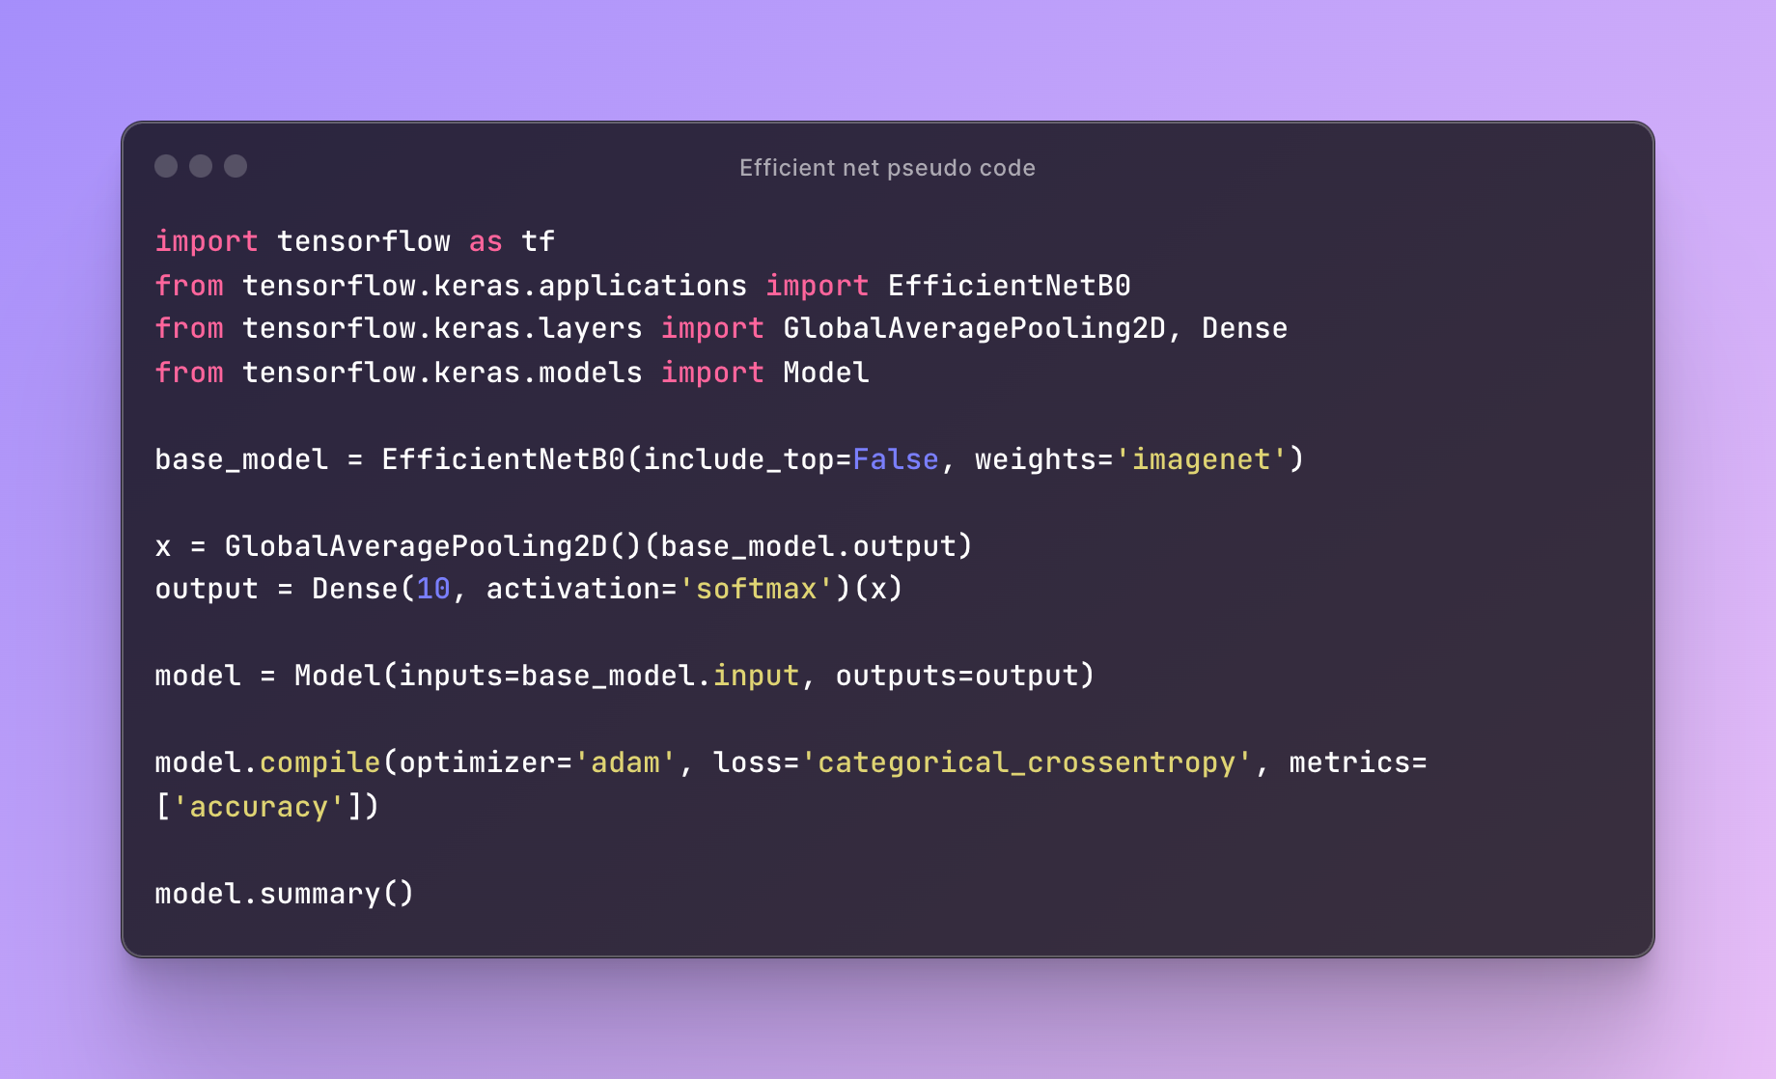
Pseudo Code: ML

Slide 21
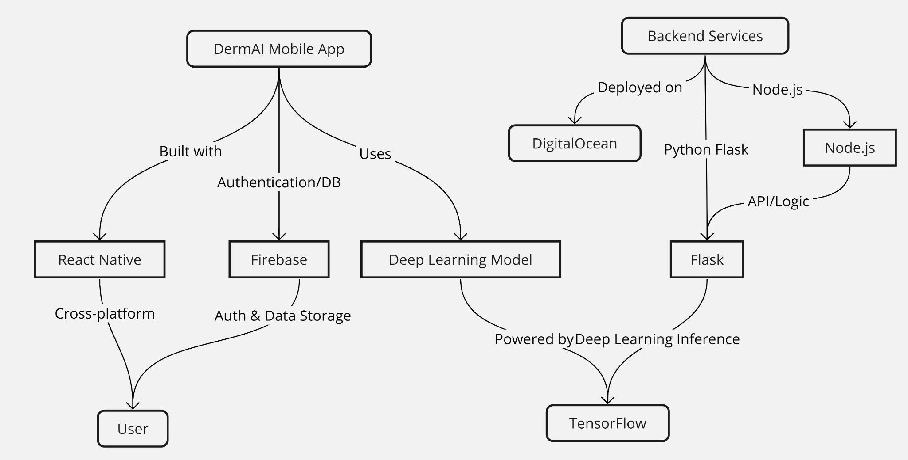
Conceptual Architectural Diagrams

Slide 22
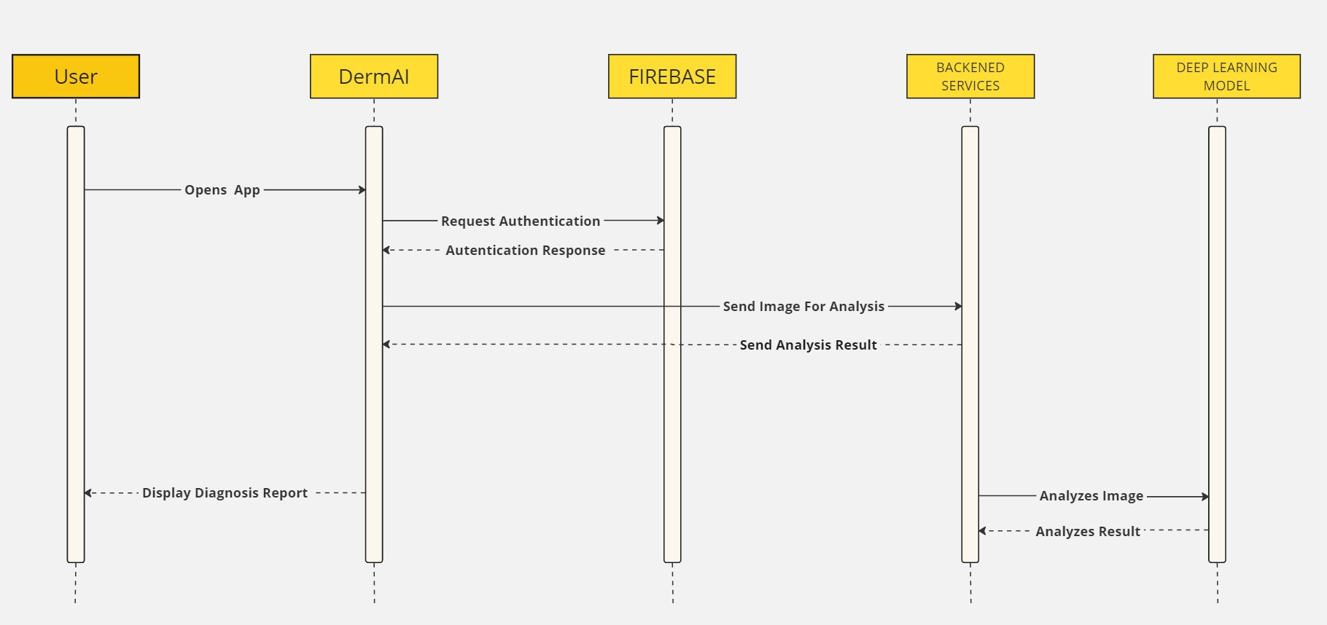
Sequence Diagrams

Slide 23
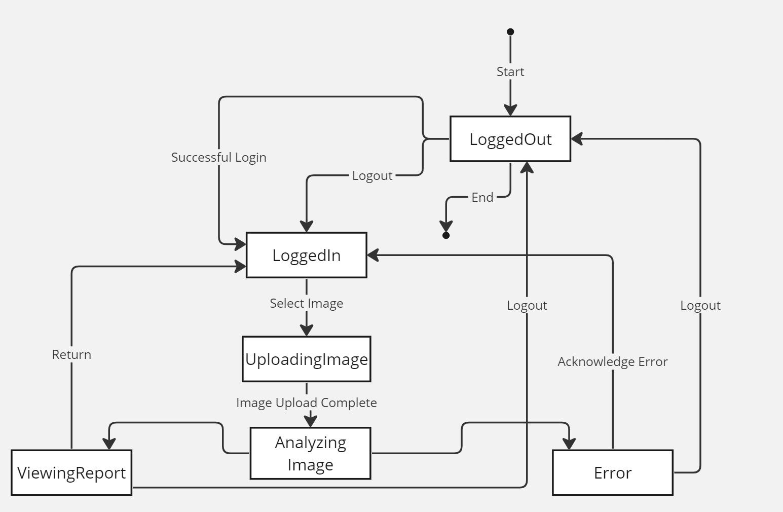
State Diagram

Slide 24
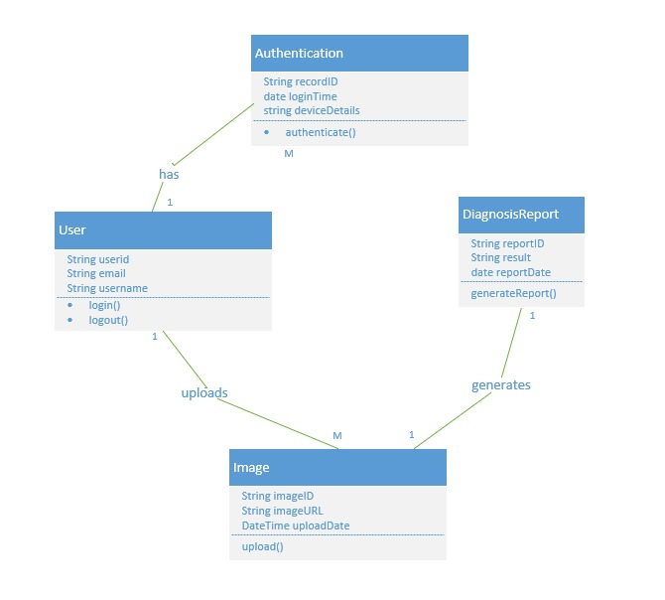
Class Diagram

Slide 25
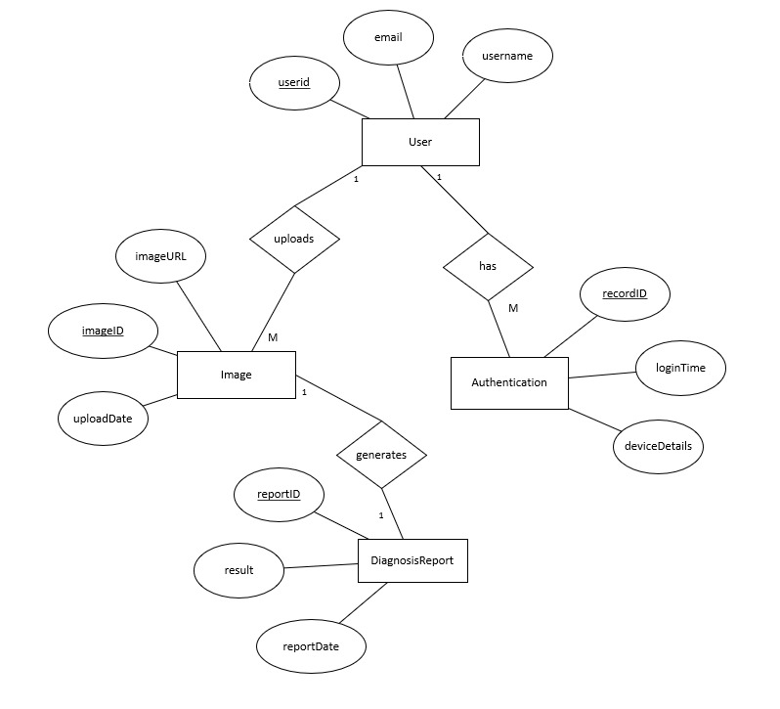
Entity Relationship Diagram

Slide 26
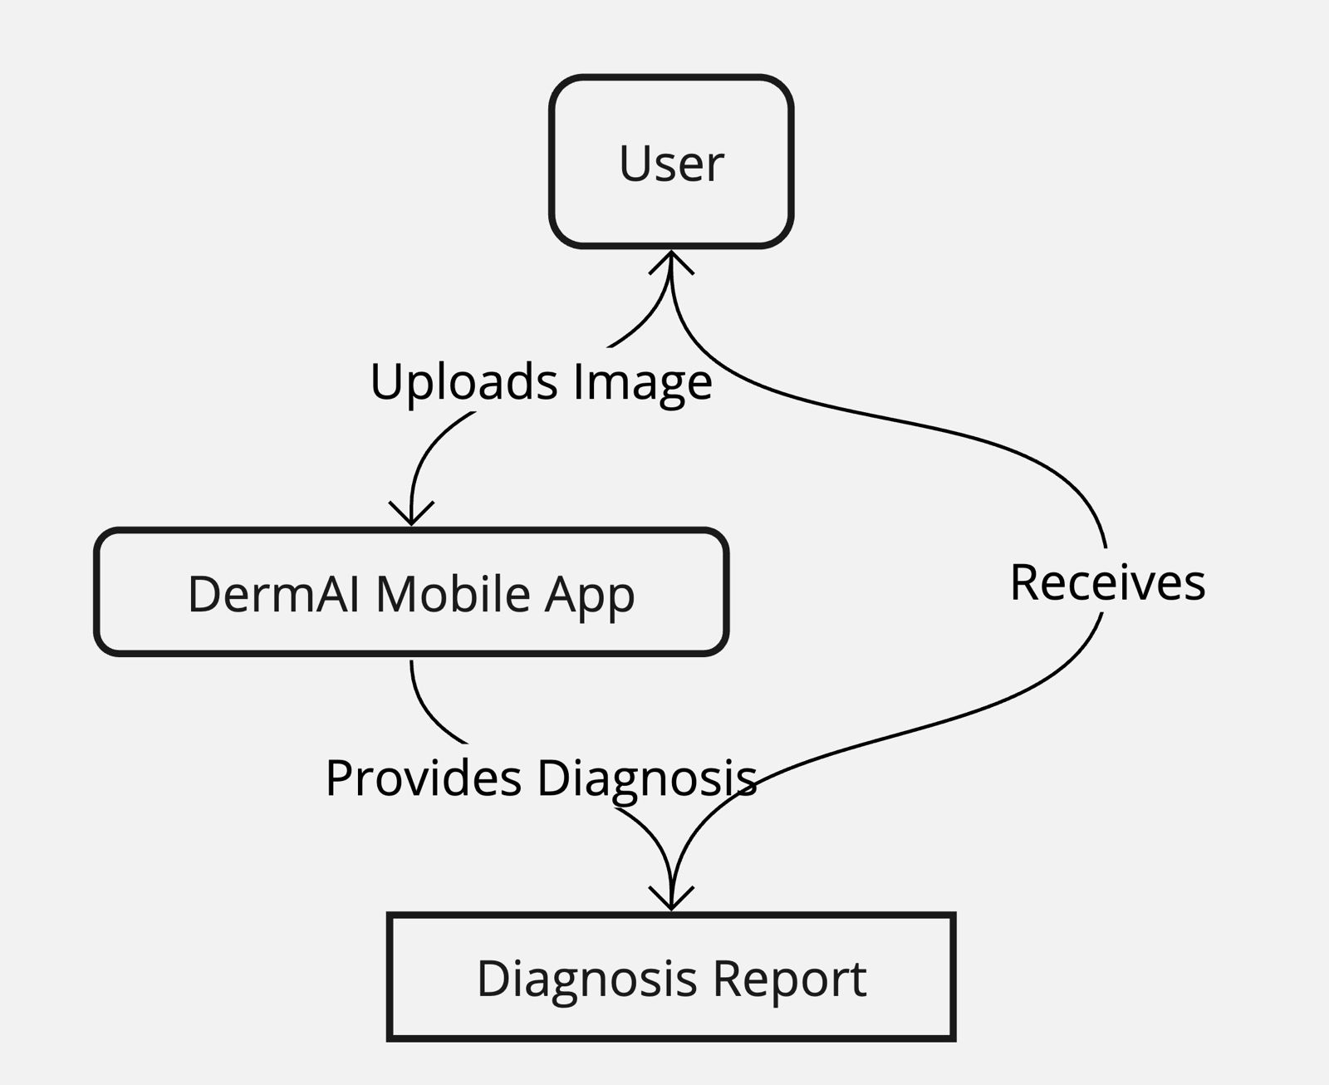
Context Diagram

Slide 27
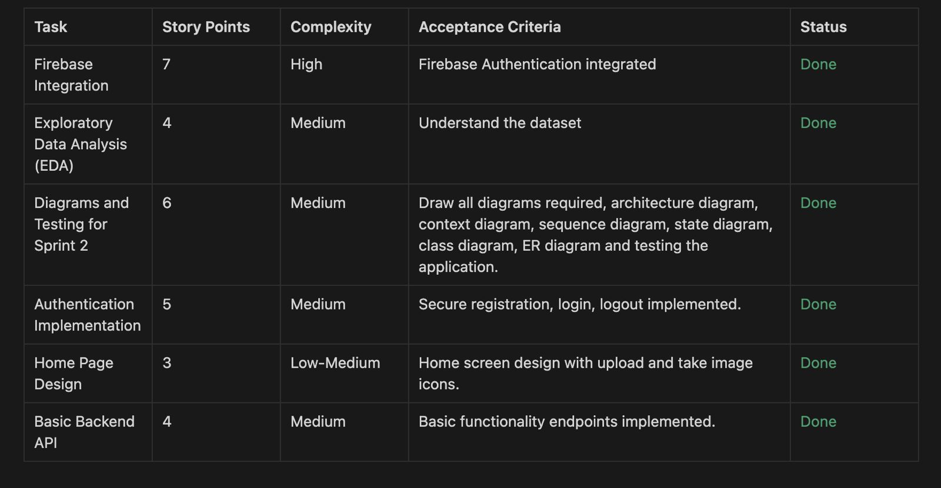
Sprint 2 Tasks and Stories

Slide 28
Team Velocity
29 Story Points

Slide 29
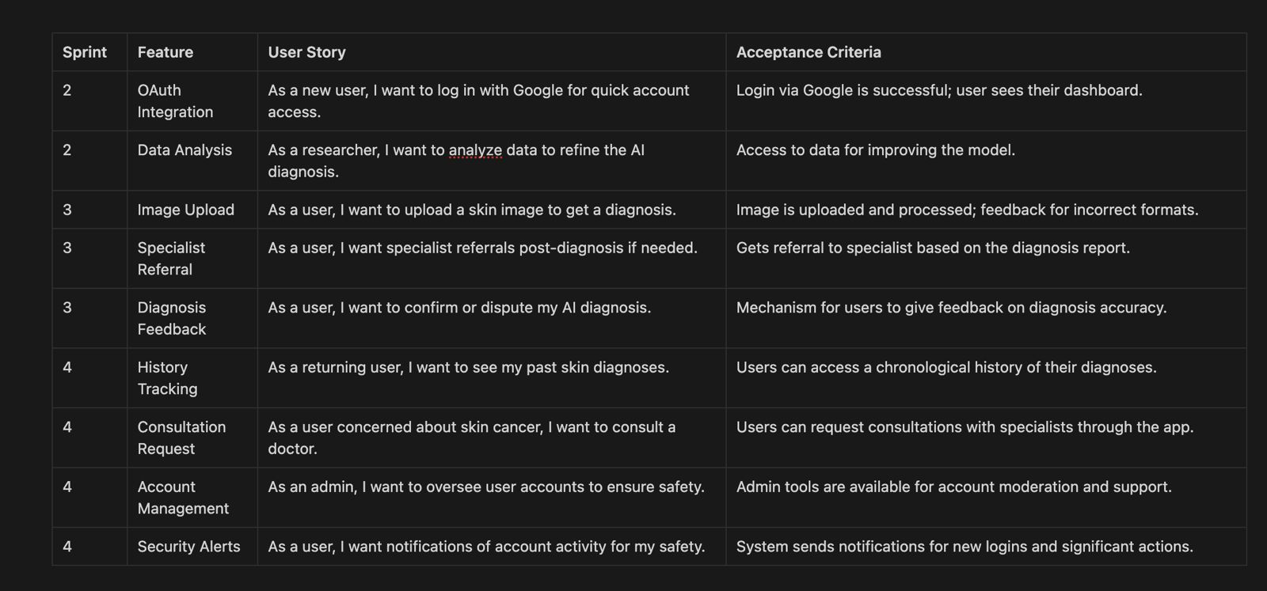
User Stories and Acceptance Criteria

Slide 30
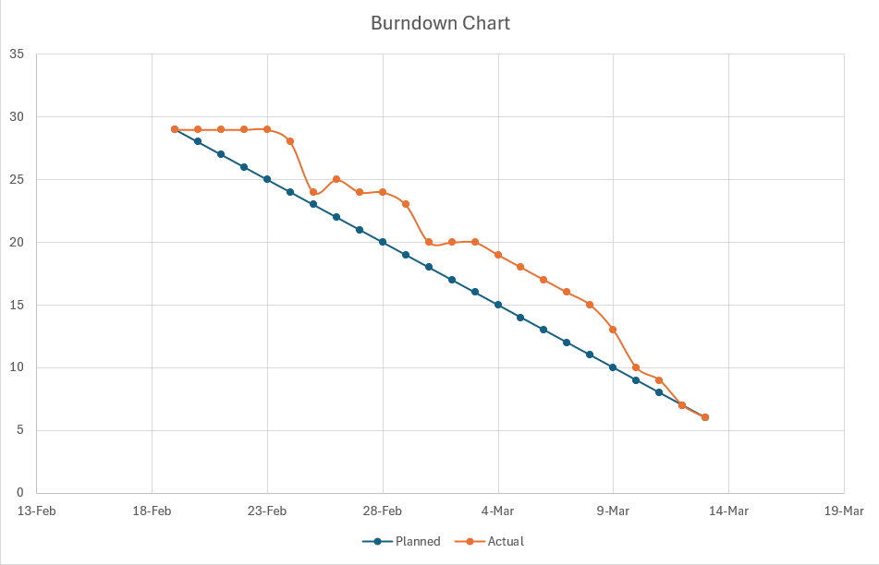
Burndown Charts

Slide 31
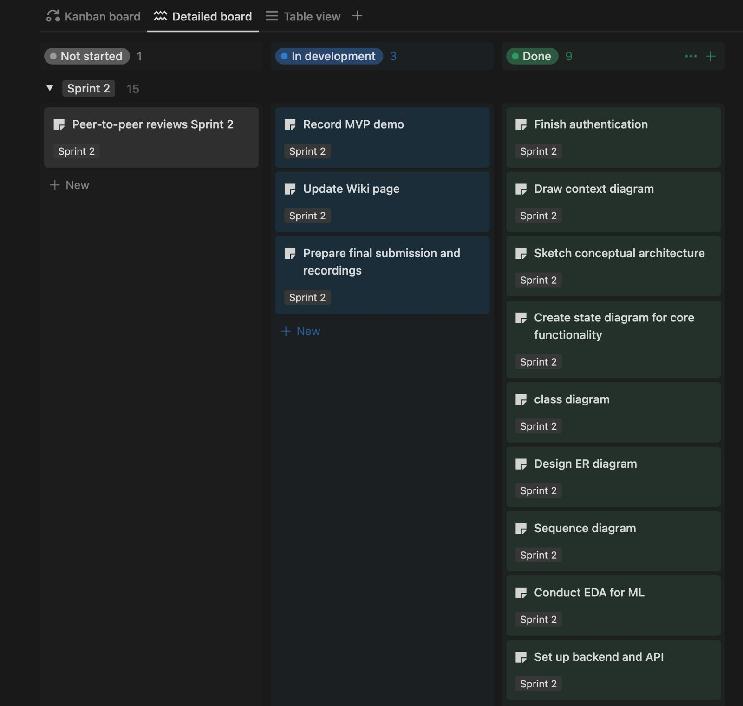
Project Schedule

Slide 32
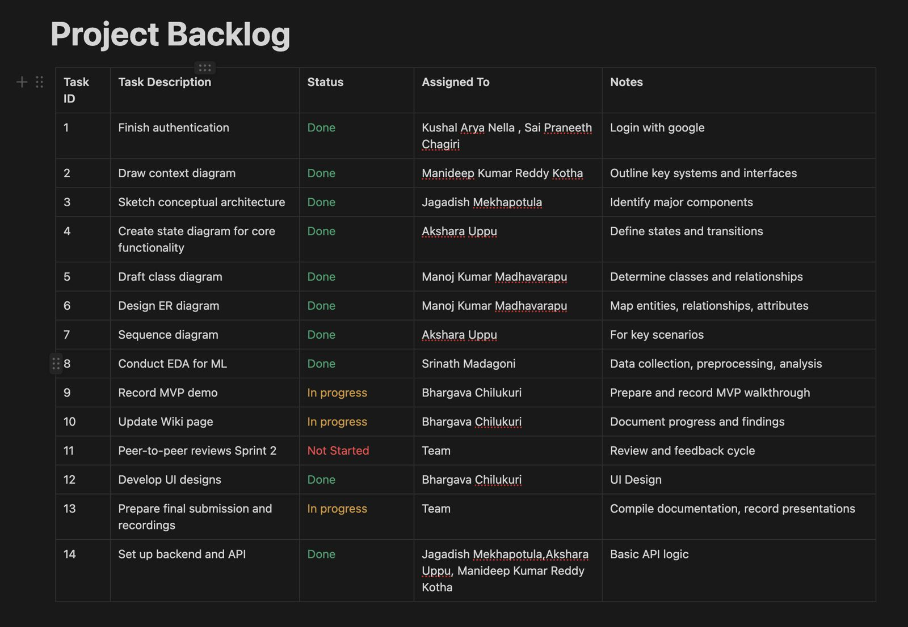
Project Backlogs

Slide 33
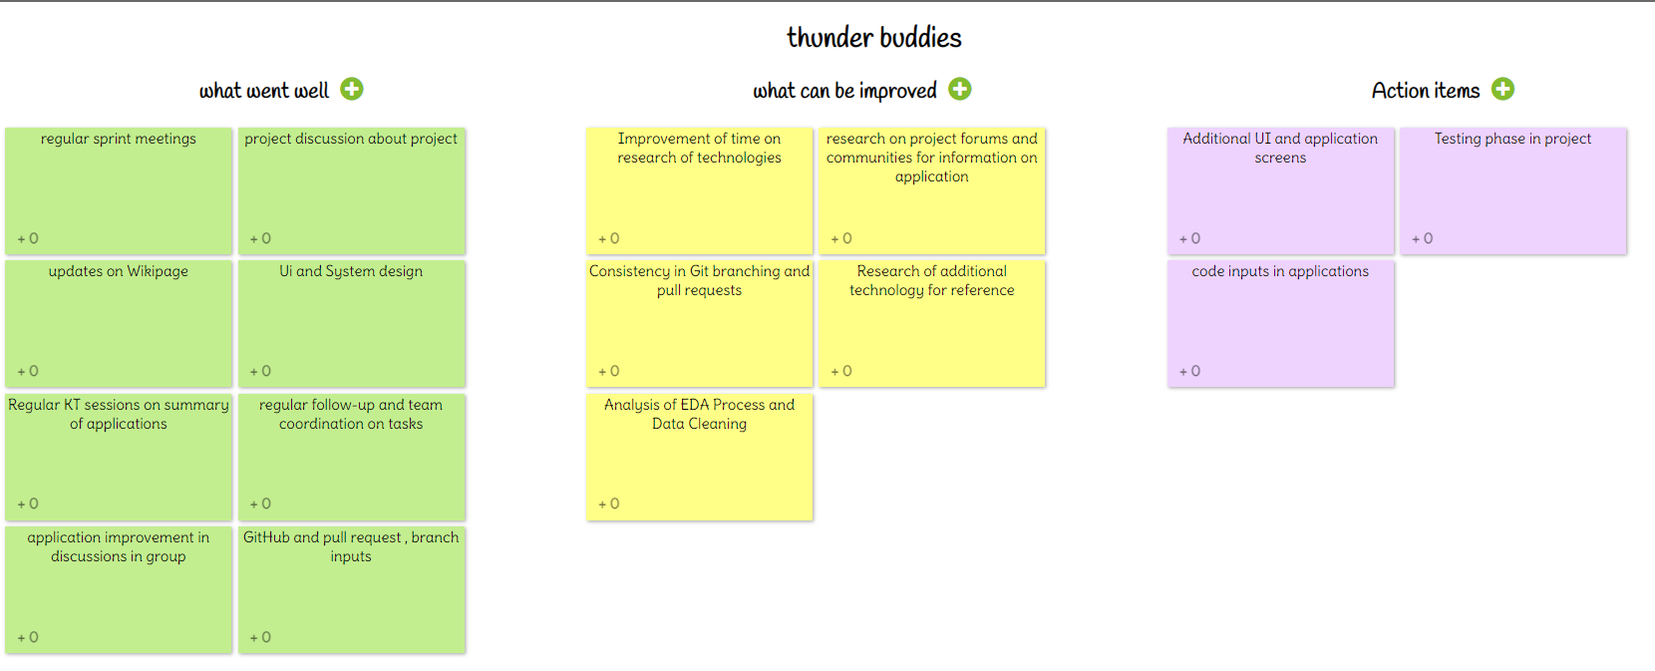
Retrospective

Slide 34
Sprint 3 Updates
Develop RESTful Image Upload API
Develop AI Diagnosis Model
Integrate AI Diagnosis Model
Firebase Cloud Storage
Use Digital Ocean Services
Dockerize Backend Services
Update User Interface Design
Automate Testing Suite
Prepare Pilot Test Plan

Slide 35
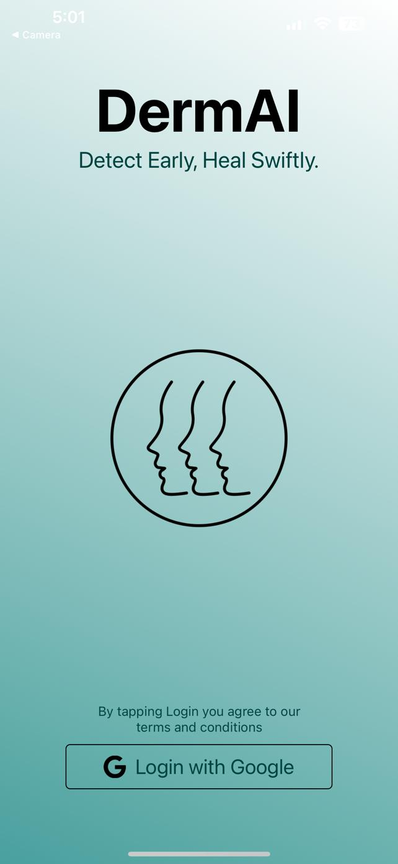
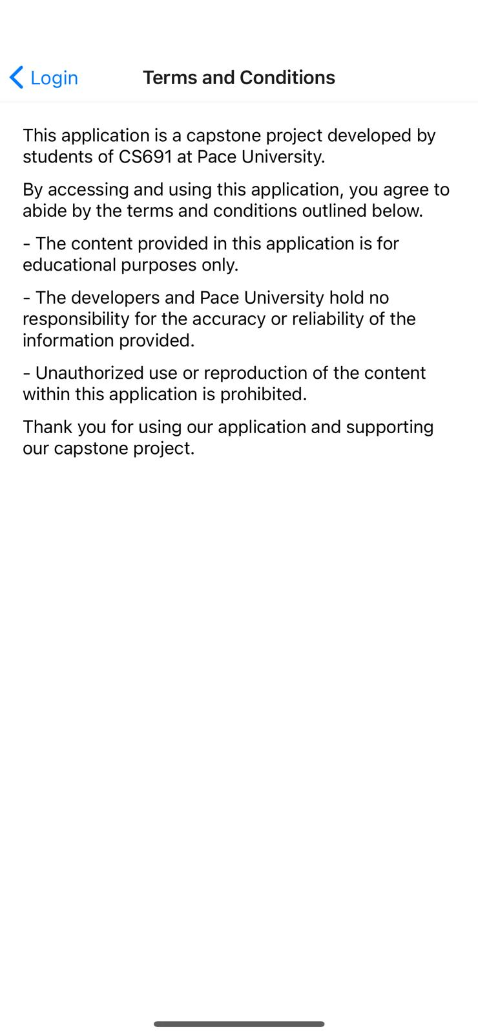
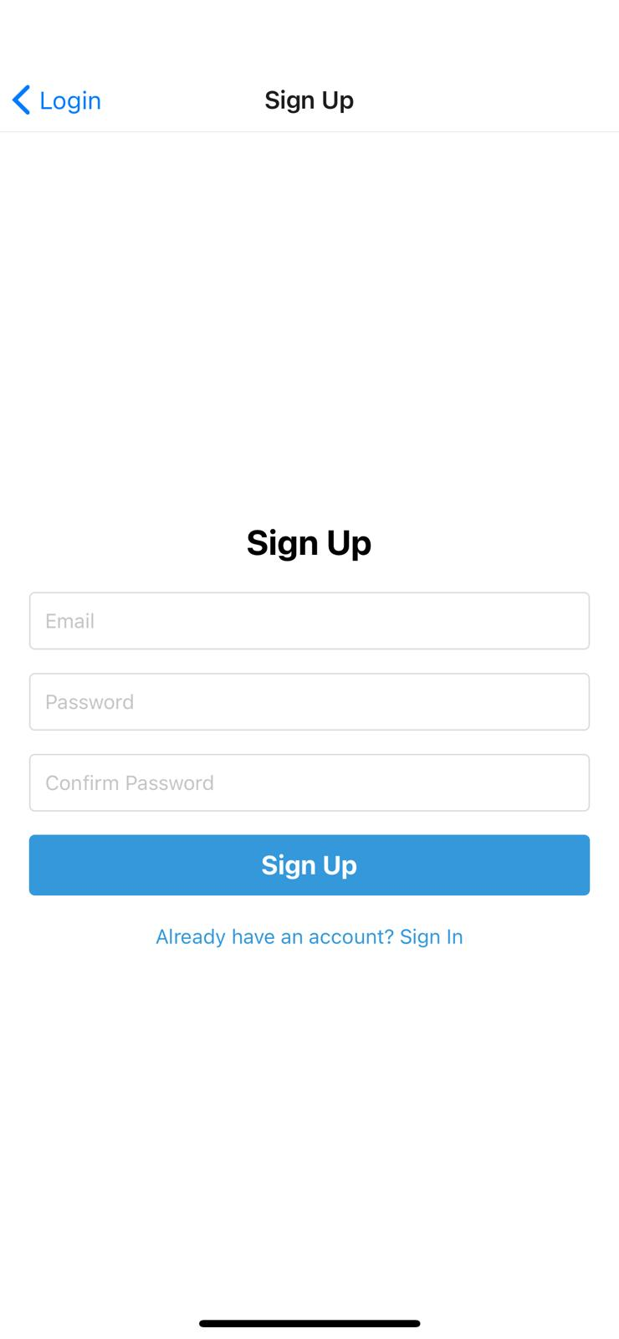
Application Screenshots

Slide 36
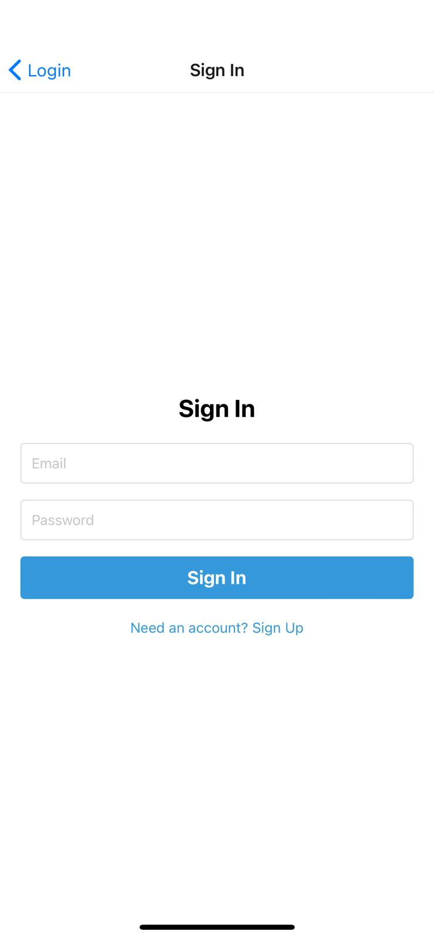
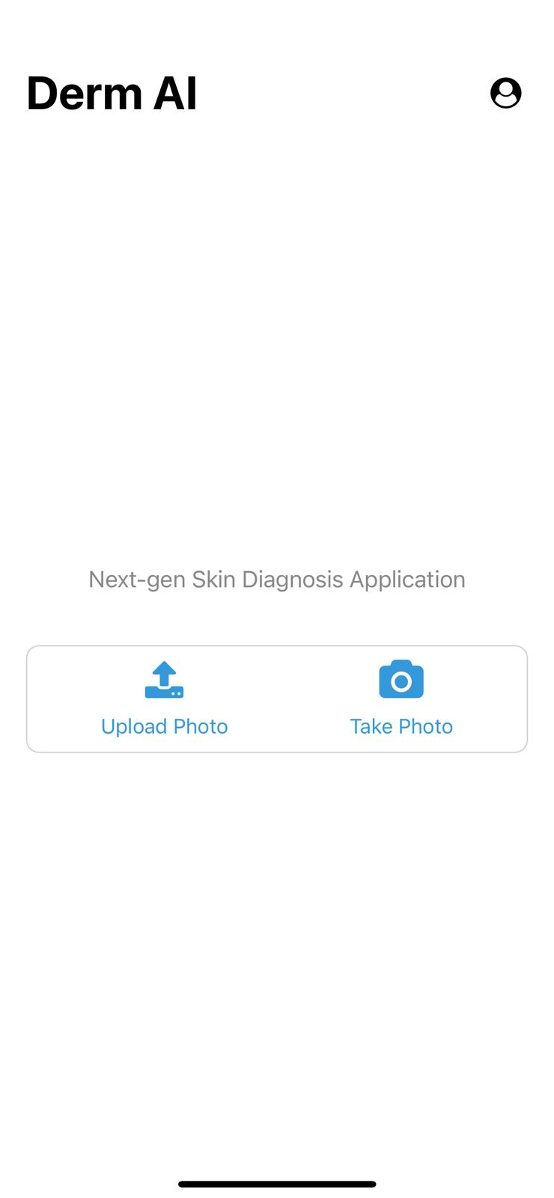
Application Screenshots

Slide 37
API and Backend
This Project utilizes Flask for machine learning, Node.js for I/O efficiency. It would Scale the components independently by enhancing application flexibility.
This application would separate concerns, enabling future expansion and microservices integration.

Slide 38
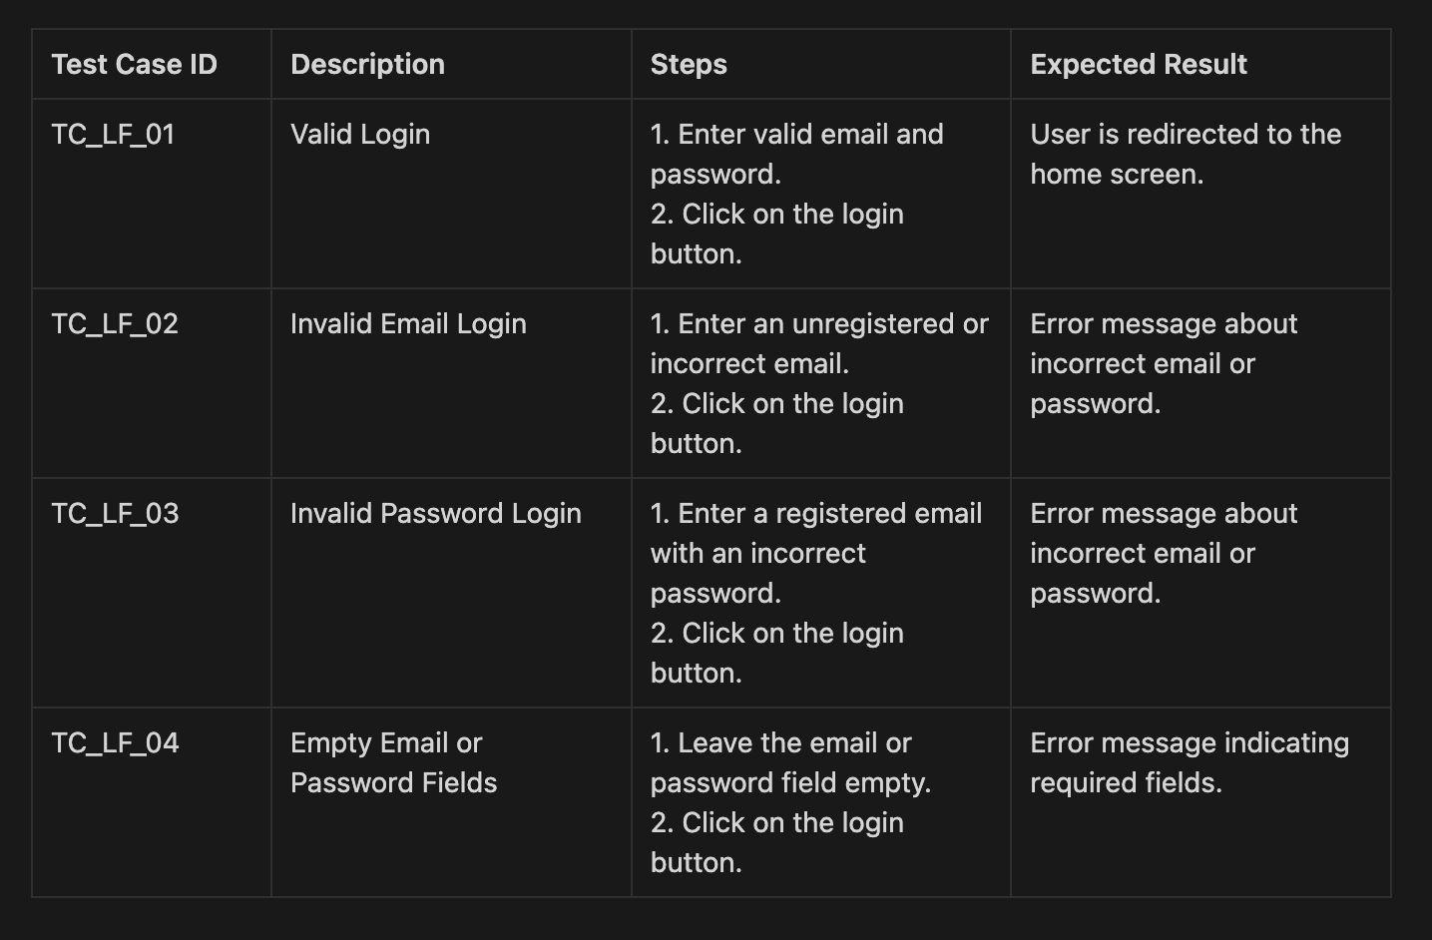
Test Cases -1

Slide 39
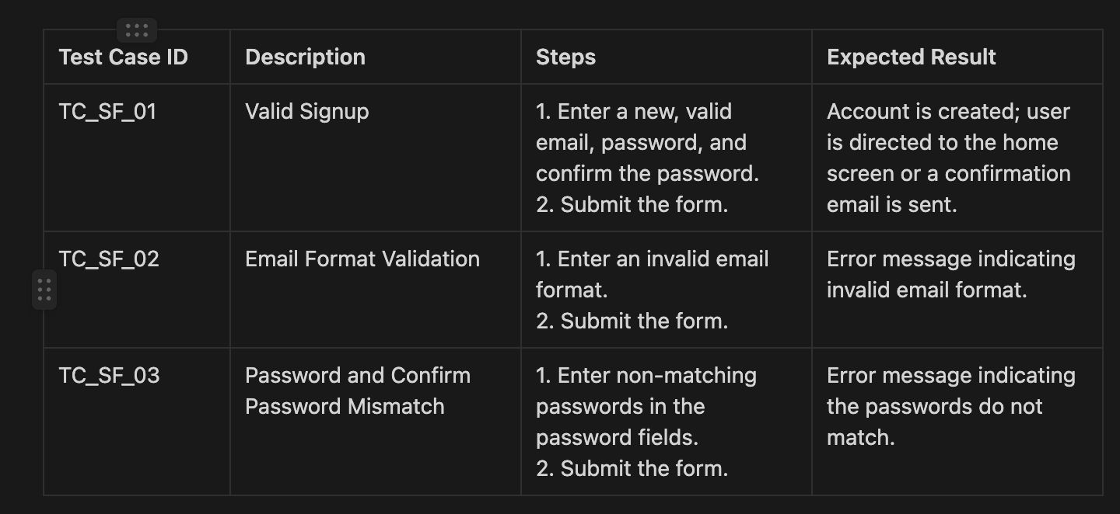
Test Cases -2

Slide 40
WikiPage
https://github.com/htmw/2024S-Thunder-Bubbies/wiki

Slide 41
Application Demo
We would be presenting application demo of our project in this presentation

Slide 42
Thank you

